Slide 1
Clackamas County Health @ Home Initiatives
Oregon Public Health Association
Panel Presentation
October 2015

Slide 2
Overview
New initiative created November 2013 focused on providing interventions targeted towards Clackamas County’s most vulnerable citizens within their homes.
Programs are focused on coordination of health services among local agencies to improve health outcomes for clients and reduce their emergency department utilization.

Slide 3
Health @ Home Programs
House RX
Bringing Health Home
Healthy Homes

Slide 4
House RX - Presenter
Presented by Cathy Perry, RN, Clackamas County Public Health Nursing Supervisor

Slide 5
House RX - Background
A quality improvement collaborative that has brought agencies that provide assessments & services within residents homes to work together to coordinate interventions and streamline processes.

Slide 6
House RX – Internal Partners
Behavioral Health Division
Housing Authority & Community Development
Public Health Nursing Program
Health Centers Division
Social Services Division
Community Solutions Division
Environmental Health Services

Slide 7
House RX – External Partners
Local healthcare providers have also been involved and can now refer chronically ill clients who may need to have home environment evaluated for safety.

Slide 8
House RX – Examples / Stories
Concerns addressed include:
Frequent falls at home
Adequate heat
Ventilation
Needs for home repairs

Slide 9
Bringing Health Home - Presenter
Presented by Concetta Branson, RN, IBCLC, Clackamas County Public Health Nurse, Bringing Health Home Program Coordinator

Slide 10
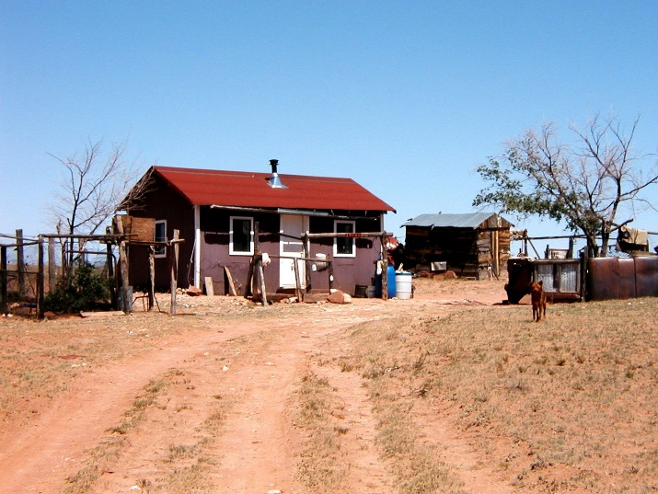
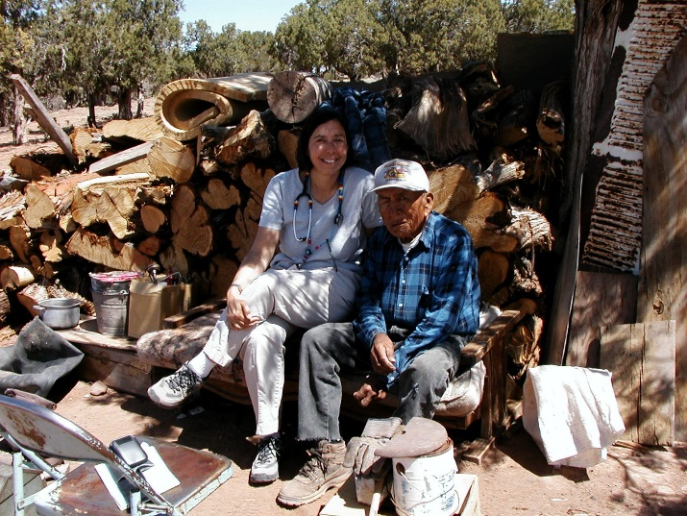
Bringing Health Home – Modeled Practice
This program is modeled on Indian Health Service Public Health Nursing Programs.

Slide 11
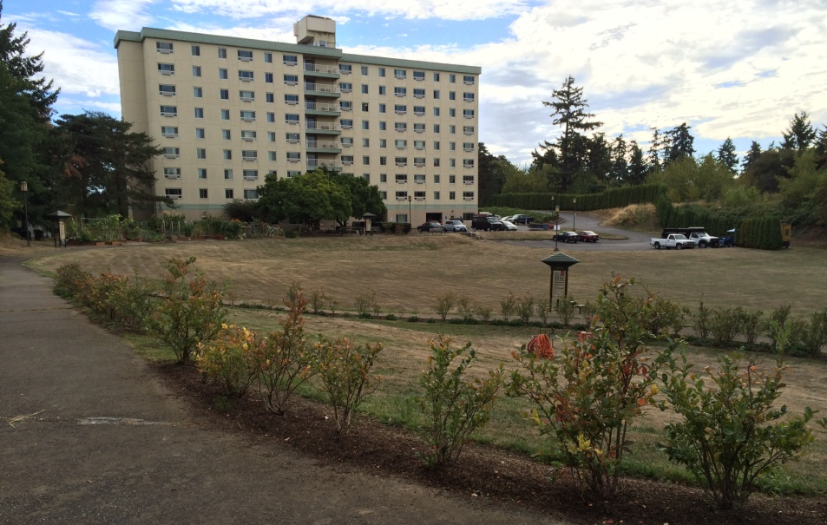
Bringing Health Home - Background
A program focused on care coordination to residents of four public housing sites in Clackamas County.
It has been funded through Care Oregon’s Innovation Program and Health Share of Oregon’s Transformation Fund (CCO).
Notes:
Residents of these communities have been identified as high utilizers of medical care and in need of interventions to give them the right care, at the right place, at the right time.

Slide 12
Bringing Health Home – Background Continued
Notes:
A Public Health Nurse is on-site and embedded at each community to help residents by providing advocacy skills, navigation assistance to connect with providers and education about the chronic conditions with which they are living.

Slide 13
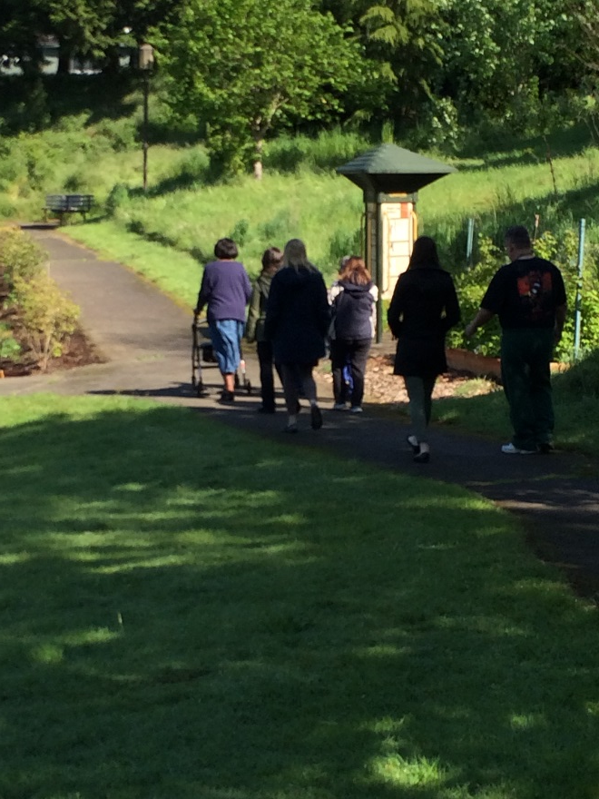
Bringing Health Home - Activities
Activities for residents include:
Walking groups;
Weight loss support groups;
Community gardens and garden potlucks;
Monthly food bank events;
Nutrition/cooking classes; and
Courses (e.g. Living Well with Chronic Conditions) are provided on an ongoing basis.

Slide 14
Healthy Homes - Presenter
Presented by Mary Horman, RN, Clackamas County Public Health Nursing Lead, Healthy Homes Program Coordinator

Slide 15
Healthy Homes - Model
Based on the Center for Disease Control Best Practice guidance and effectiveness review recommendations for asthma control programs that improves:
symptom free days;
averted costs of emergency department and hospitalization use;
school days missed and;
unscheduled office visits.

Slide 16
Healthy Homes - Background
Clackamas County has replicated a successful program that Multnomah County has had in place for several years known as Healthy Homes. The goal of this program is to improve asthma control within vulnerable children’s homes.
This program is funded thanks to Health Share of Oregon’s Transformation Fund (CCO).

Slide 17
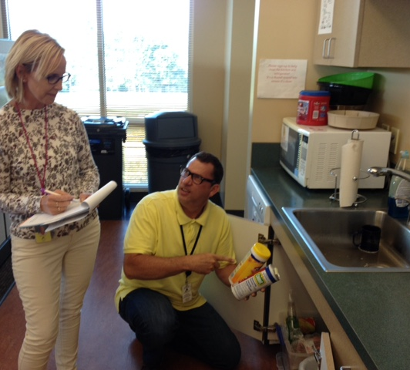
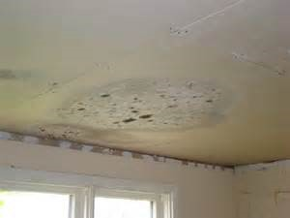
Healthy Homes - Approach
The Public Health Nurse develops individual’s Asthma Control Plans, which make improvements to the home environment and provide funding for essential items to keep a home asthma friendly.

Slide 18
Healthy Homes – Outcomes in Progress

Slide 19
Q & A
Opportunity for questions from the audience.
Thank you for choosing to attend this afternoon’s panel. Have a great rest of your OPHA Conference!

Slide 20
Contact Information
Cathy Perry, House RX Coordinator
CathyPer@clackamas.us
(503) 742-5382
Concetta Branson, Bringing Health Home Coordinator
ConcettaBra@clackamas.us
(503) 742-5372
Mary Horman, Healthy Homes Coordinator
Mhorman@Clackamas.us
(503)742-5949

